Slide 1
Varian E500 SOURCE AREA
Maintenance Report
PM Type: PM,QPM, WPM, MPM, YPM
MACHINES: E500-1, E500-2, E500-3, E500-4
Presented By: SAMUEL - 山姆爾
IMPLANTER-Diffusion Department [S220]

Slide 2
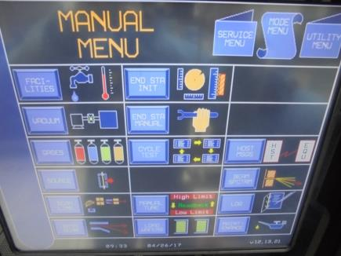
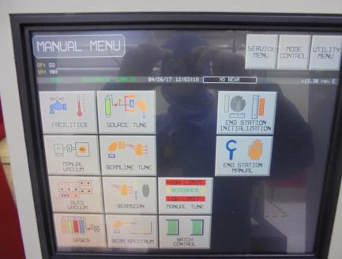
* Machine Cool Down/Shutting-Off BEAMLINE and SOURCE AREA
A
B
E500-1 and E500-2 Monitor Panel
[MANUAL MODE]
E500-3 and E500-4 Monitor Panel
[MANUAL MODE]
Software Version:V12.13.21
E500-3 Software Version: V13.2 rev B
E500-4 Software Version: V13.3 rev E

Slide 3
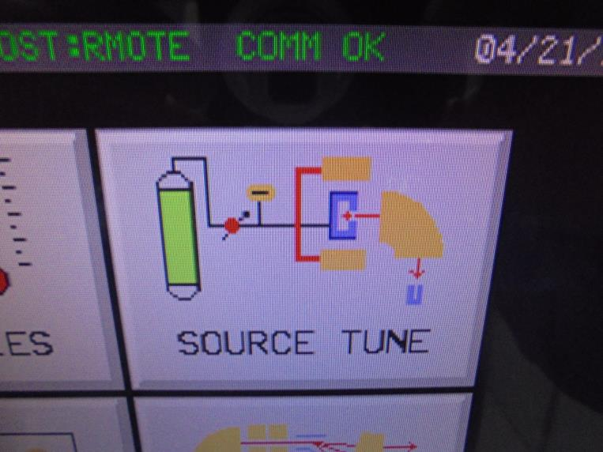



Slide 4

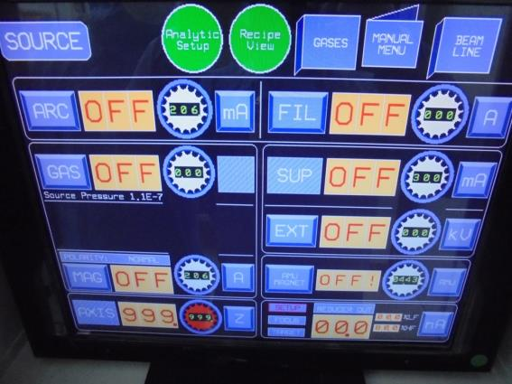
Set To 0 and Turn-Off The Following:
-ARC-60V
-select mA
-set to 0 mA
-OFF
-FIL
-adjust to 0 A
-OFF
-GAS
-set 0
-OFF
-EXT
-adjust to 0 kV
-OFF
-MAG
-set to 0 A
-OFF
-AMU MAGNET
-adjust to 0 A
-OFF

Slide 5
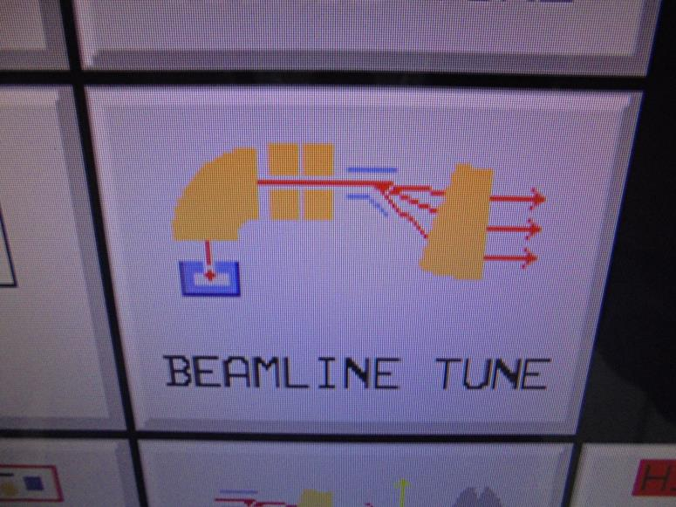

Slide 6
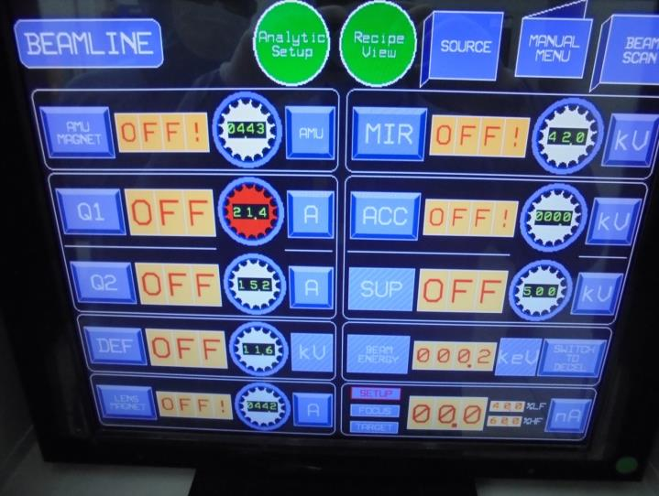

adjust to 0 OFF!
ACC
set-0
OFF!

Slide 7
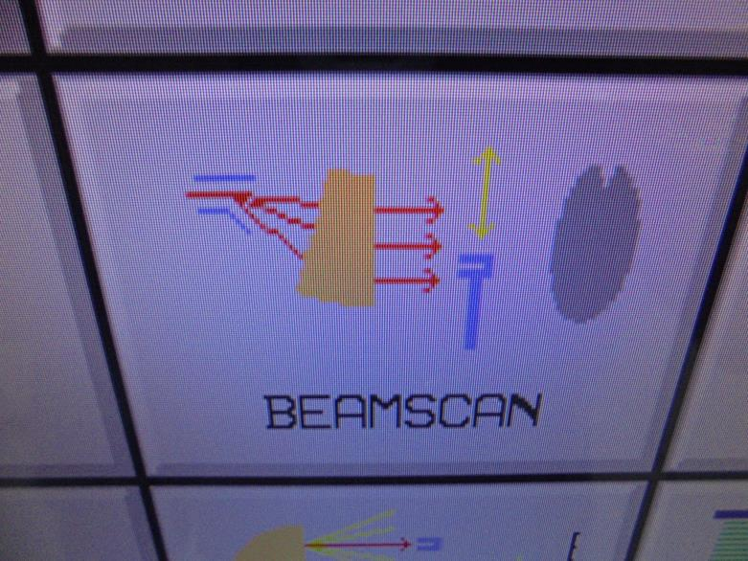

Slide 8
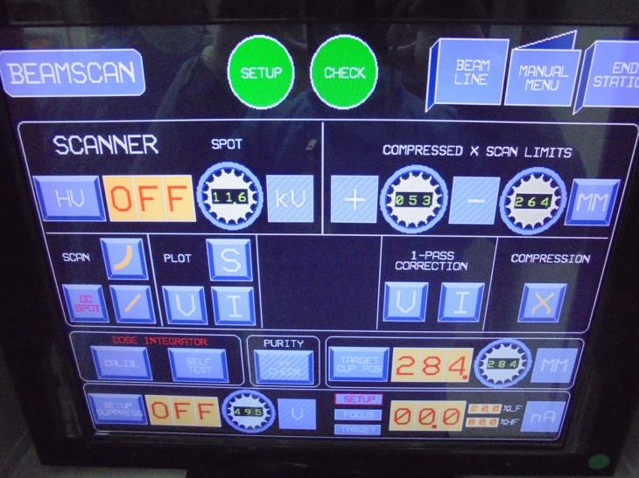
OFF!
FOCUS
OFF!

Slide 9
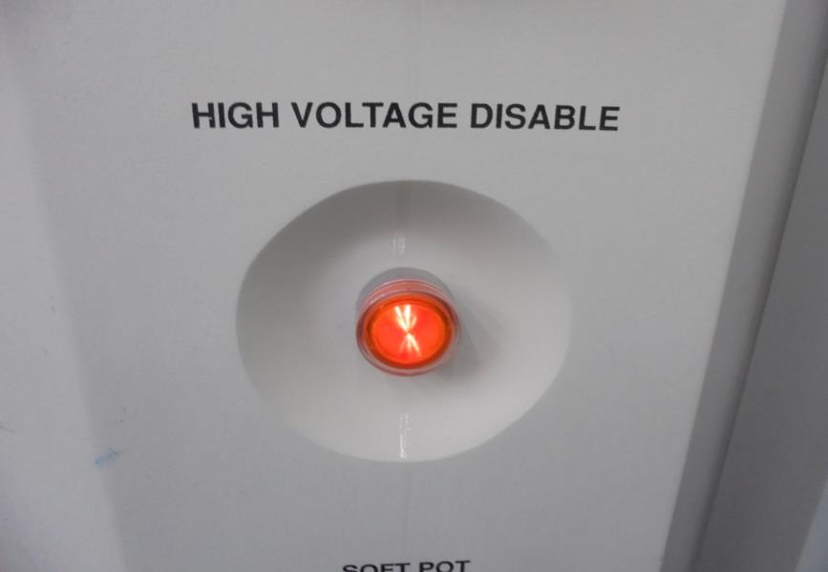


PRESS THE BUTTON
To shut-off HIGH VOLTAGE
note: Light ON Indicates HV
is Already Disable .

Slide 10
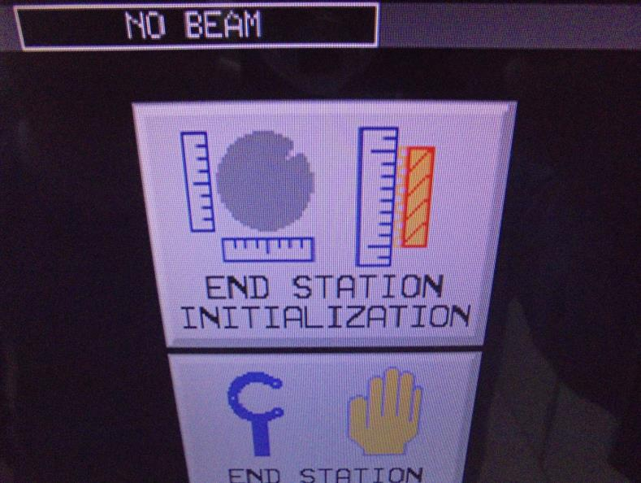

Slide 11
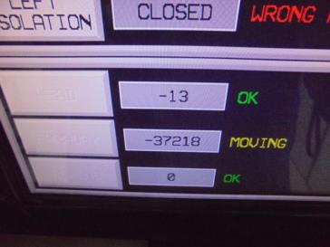
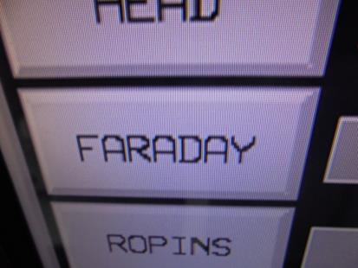
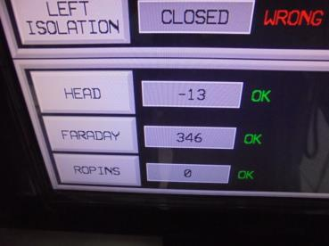


*FARADAY INITIALIZING
FARADAY IS MOVING TO HOME POSITION
FARADAY IS IN HOME POSITION

Slide 12
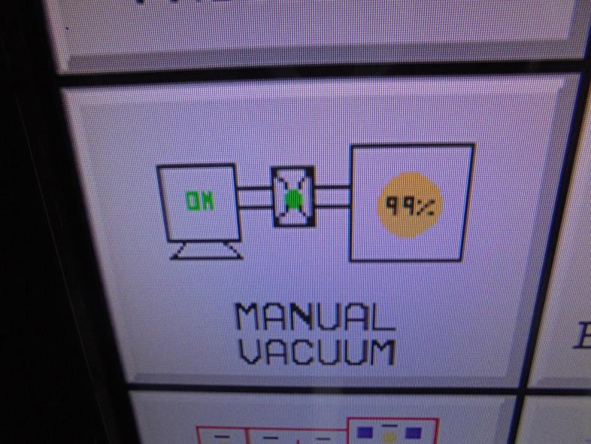

Slide 13
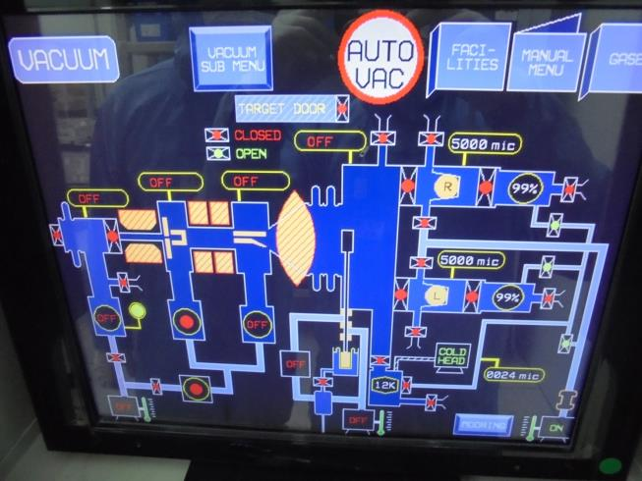
CLOSE THE FOLLOWING VALVES…
1.ISO
Valve
2.GATE
Valve
3.Source FORE-LINE
*E500-3 PANEL MONITOR
4.Turbo Pump
[SOURCE AREA]
5.Beam
FORE-LINE
6.Turbo Pump
[BEAM LINE]

Slide 14
Replacing Clean Spare Of
SOURCE HEAD and ELECTRODE
Maintenance

Slide 15
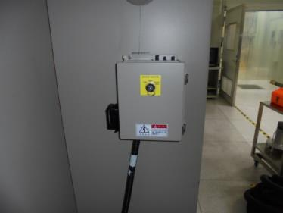
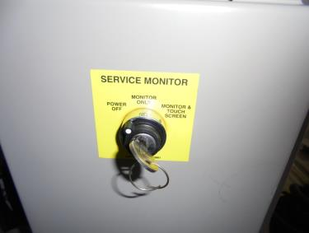

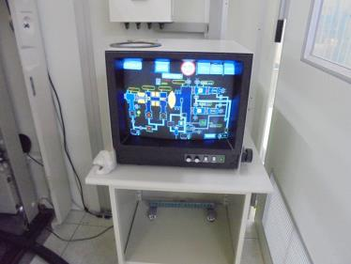

Proceed At The Back Of Machine…
A
B
Switch…
FRONT PANEL
REAR PANEL
Monitor control switch
“MAINTENANCE
SERVICE
MONITOR!”
C

Slide 16



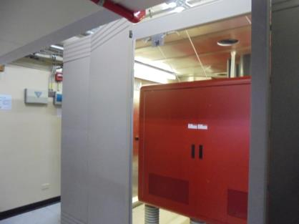
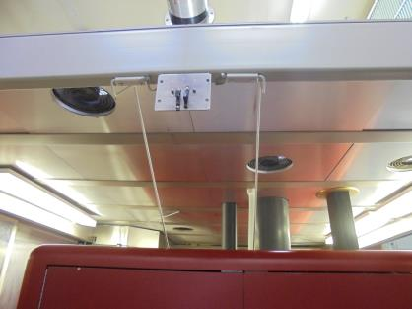
*For SAFETY PURPOSE… Machine Have A
HAZARD HIGH VOLTAGE CURRENT…
OPEN The BACK DOOR Of The Machine
To Activate The INTER-LOCK. [GROUND]
INTER-LOCK
Make Sure The INTER-LOCK Rod [GROUND] Is
Touching On The Top Surface Of The Machine …

Slide 17
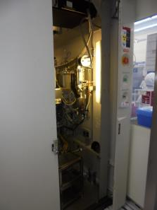
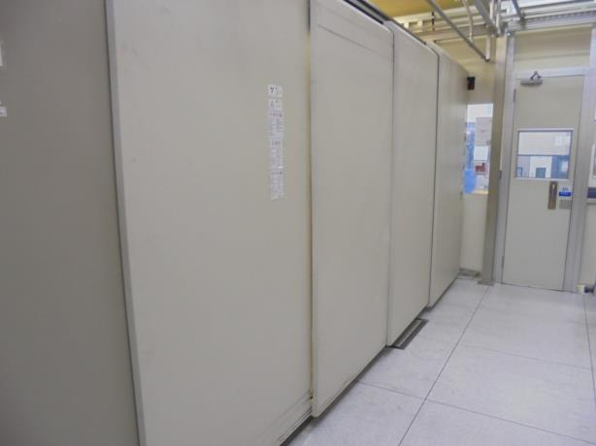
Open SOURCE AREA Outer Door…
Light Indicator Must Be OFF
[PROCESS AREA]
Slide To Open
SLIDE to OPEN

Slide 18


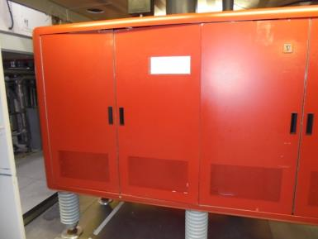
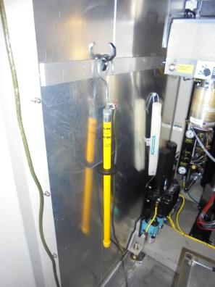

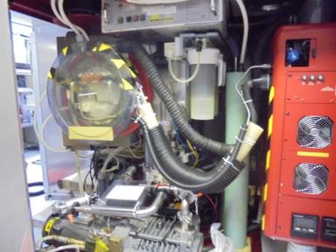


*Use A Safety Tool To Eliminate Static
Charges Residue Before Touching The
Machine Parts Surfaces…

Slide 19
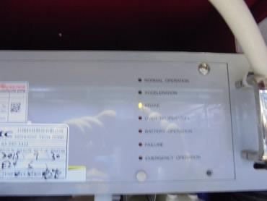
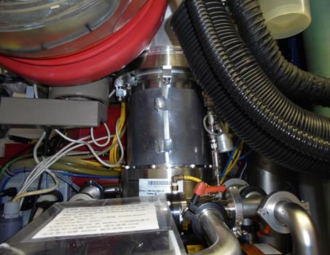
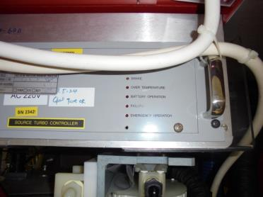
A
*When Source Area TURBO PUMP Shut-Off, It Speed Decrease.
Takes 40 Mins. To 1 Hour Machine Chamber To Cool Down.
The SOURCE AREA
TURBO PUMP
B
*TURBO PUMP Was Already STOP [LIGHT INDICATOR OFF].
Wait For Another 5 Mins. Then Do The MANUAL VENT…

Slide 20
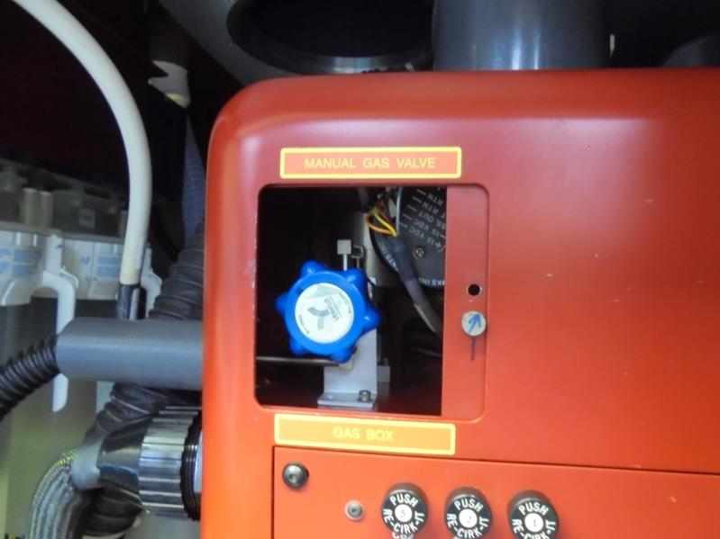

CLOSE THIS
VALVE FIRST!
CLOSE

Slide 21
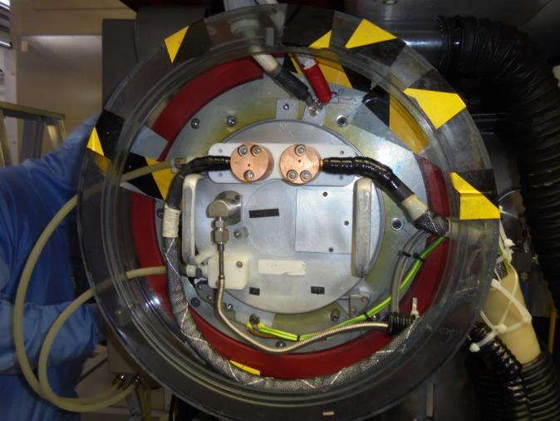
*REMOVE THE
EXHAUST PIPE,
CHANGE WITH
LOW VACUUM
A
*UNPLUGGGED
THE FILAMENT
CABLE…
B
*REMOVE A. ENERGY PROBE CABLES
B. FILAMENT CABLE GROUND

Slide 22
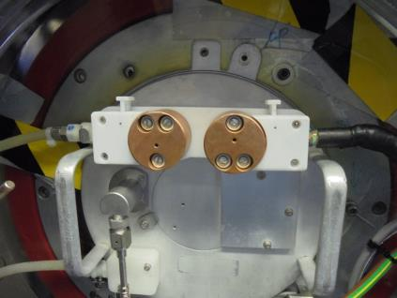
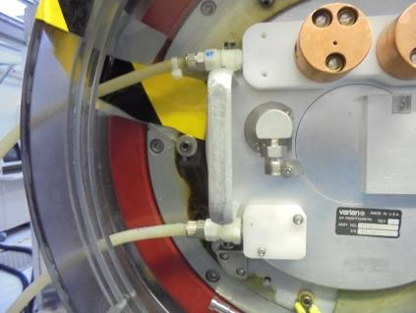
Conduct Manual VENTING on SOURCE CHAMBER…
*Unplugged The Cooling Line…
*Dis-Connect The GAS LINE On SOURCE HEAD
[MAKE SURE THE MANUAL GAS VALVE IS CLOSE]
*Wait Until The Source Chamber Reach
The “ATMOSPHERIC PRESSURE”…
*REMOVE The Source Head.

Slide 23
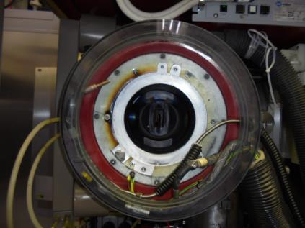
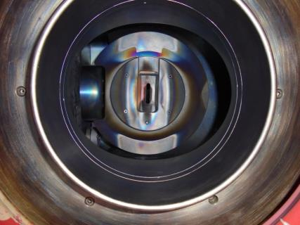
*Inside the SOURCE CHAMBER
Extraction ELECTRODE

Slide 24
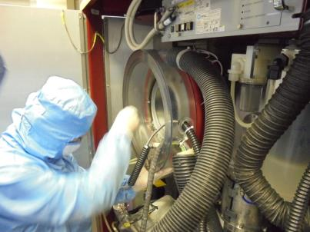
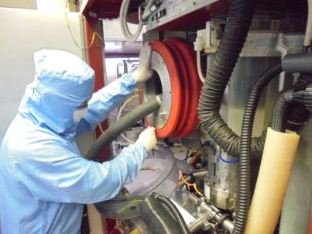

*Remove The SOURCE SHROUD
*Remove SOURCE FLANGE
[ 8 SCREWS]

Slide 25

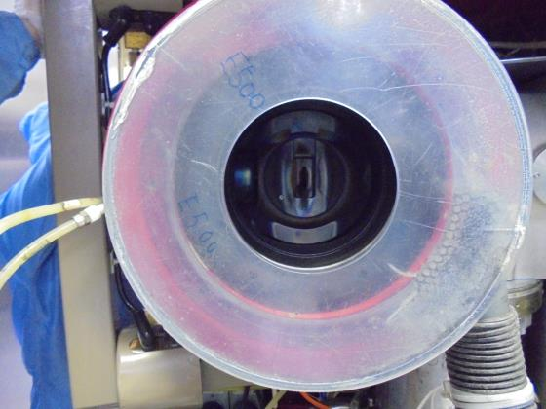
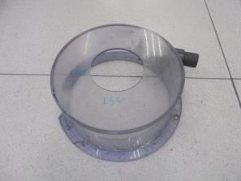
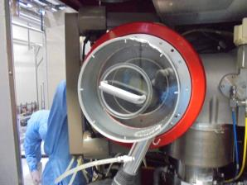
E500
A
SOURCE HOOD
B
Install The SOURCE HOOD
Attached The Low Vacuum
Let It Suction Any “Elements” or Gasses Residue Inside… Proceed To ELECTRODE
NEW MODIFY

Slide 26

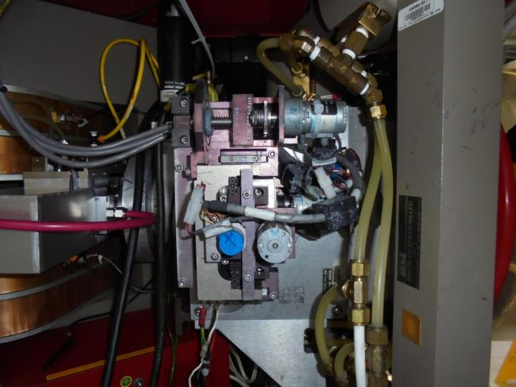

EXTRACTION MANIPULATOR ASSY. [ ELECTRODE ]
There Are
4
MOUNTING
SCREWS
Located On
This Area…
[REMOVE LATER]
note: Switch-Off
SOURCE MAGNET
POWER SUPPLY…
SOURCE AREA
AMU MAGNET
[PUSH]

Slide 27
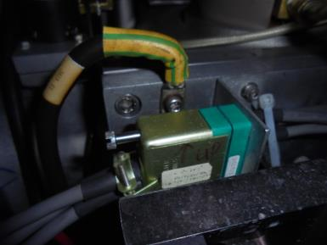
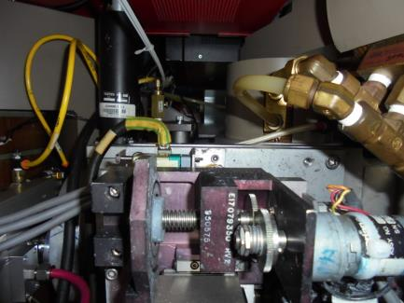

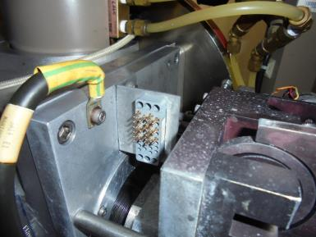
B
MANIPULATOR ASSY. MOTOR
Power Supply
A
Unplugged The P.S.
C
Remove The Ground

Slide 28
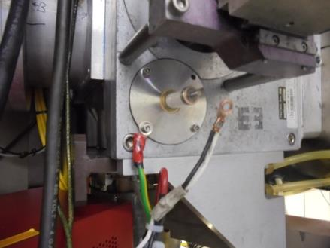
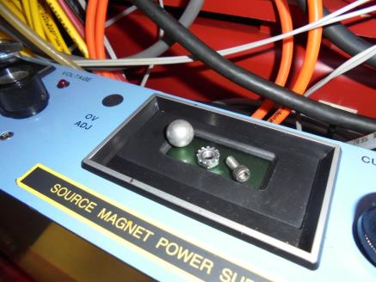
B
A
A. Remove Screw [ GROUND ]
B. Ball Nut / Female Nut
[HIGH VOLTAGE FEED-THRU]

Slide 29
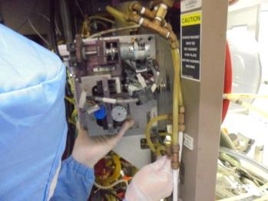
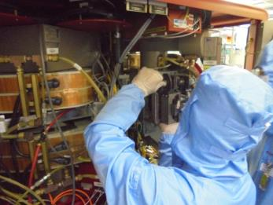
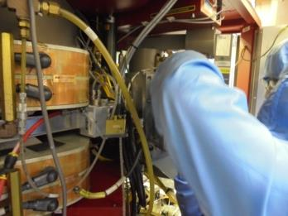
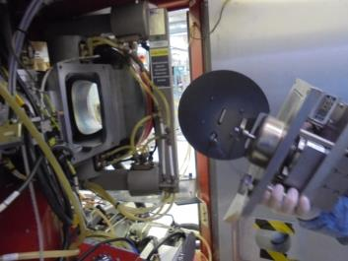
A
B
Loosen The 4 Major Screw
1 Hand Support On The Base Of
MANIPULATOR ASSY.
C
D
Carefully Take-Out The MANIPULATOR ASSY.

Slide 30
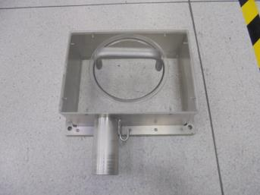


Use Low Vacuum To Clean Gas Peel
Residue Inside The Chamber…
A
NEWLY MODIFY HOOD
B
You Can Attached LOW VACUUM Here
[OPTIONAL]

Slide 31

CLEAN SPARE
FOR MAINTENANCE

Slide 32




Remove Source AMU Fix Frame [2 Screws]
Transfer To Clean Spare Secure The 2 Screws…
A
B

Slide 33


Clean The Inside Surface Of MANIPULATOR ASSY. Using IPA

Slide 34

Clean The Mounting Surface Of The Chamber…

Slide 35

Carefully Install The Clean Spare…

Slide 36


A
B
With 1 Hand Supporting On The Base…
…Secure The 4 Screws Each Side

Slide 37



A
B
Re-Install The Ground
Re-Connect The POWER SUPPLY
*Check The MOTOR Is Functioning When
Connecting The POWER SUPPLY

Slide 38

Make Sure The HIGH VOLTAGE WIRE Is Not Touching On The Chamber Wall…
Proceed Again To SOURCE HEAD Area

Slide 39




*Clean The SOURCE BUSHING Using H202…
Ware A Proper Gloves!
note: This Chemical Is…
-Skin and Eye Irritant
-Oxidant
-Corrosive
-Harmful
-Stingy Smell
[Please Do Follow The Proper Use]

Slide 40




Clean Inside The Source Bushing
-Keep Your Hand Suction On Low Vacuum
When H202 Is Oxidizing…
-Remove Your Gloves Inside After Cleaning

Slide 41




Clean With IPA
*Allow Low Vacuum Attached To SUCTION
And DRY The Chamber Inside…

Slide 42

Clean The SOURCE FLANGE
REMOVE 0-RING

Slide 43




Clean SOURCE FLANGE Using H202 To Remove GAS COATING
A
B
SPRAY
SCRUB CLEAN NEAR O-RING SLOT
C
D
CLEAN INSIDE SURFACE
CLEAN OUTSIDE SURFACE

Slide 44


*Clean With IPA. Let It Dry
*Clean and Check O-Ring. Re-Install

Slide 45




Re-Install The SOURCE FLANGE
A
B
REMOVE SOURCE HOOD
CLEAN MOUNTING SURFACE
C
D
A
INSTALL…
SECURE TIGHT 8 SCREWS

Slide 46




RE-INSTALL SOURCE SHROUD
RE-INSTALL THE FILAMENT GROUND
RE-INSTALL ENERGY PROBE CABLE
FOR SOURCE HEAD INSTALLING…

Slide 47




E500 SOURCE HEAD
RE-CHECK ISOLATION
RE-CHECK IF SCREW TIGHTEN
CLEAN O-RING AREA

Slide 48




*Installing The SOURCE HEAD
CHECK FILAMENT ORIENTATION
CAREFULLY SLID INSIDE THE CHAMBER
CHECK IF PROPERLY MOUNTED
RE-CONNECT THE GAS LINE

Slide 49




TIGHTEN THE GAS LINE
RE-CONNECT UPPER COOLING [IN]
RE-CONNECT LOWER COOLING [OUT]
RE-CONNECT FILAMENT CABLES

Slide 50

Double Check Again If The Components
Is Properly Inserted / Mounted…

Slide 51






1
2
A.
B.
OPEN THE MANUAL GAS VALVE
A. OPEN SOURCE TURBO PUMP
B. OPEN SOURCE FORLINE
3
4
CHECK SOURCE TURBO CONTROLLER INDICATOR
IF TURBO PUMP IS ACCELERATING
CHECK SOURCE HEAD COOLING LINE
FOR ANY WATER LEAKAGES

Slide 52





5
6
PUT BACK THE SOURCE SHROUD COVER
-SELECT- [ AUTO VAC ]
7
8
VENT THE BEAMLINE [ AUTO VACUUM ]
OPEN [ TP CONTROL UNIT ]

Slide 53




9
10
CHECK IF THE FAILURE INDICATOR LIGHT ON
PRESS BUTTON – “STOP” TO RESET TP STATUS
11
12
ACCELERATION INDICATOR - ON - OK!
CHECK BEAMLINE TP CONTROL IF ACCELERATING
[ Refer on ACCELERATION INDICATOR ]

Slide 54





13
14
Slide To Close
CLOSE THE INNER DOORS
CLOSE THE OUTER DOORS
15
16
Enable The HIGH VOLTAGE
Switch OFF The SERVICE MONITOR

Slide 55



A
B
1.
2.
3.
-FRONT MONITOR PANEL-
Type: SOURCE-FORELINE ON [ENTER]
RUN [ENTER]
STOP AUTO-VAC
IF SOURCE FORELINE VALVE IS CLOSE
OPEN THE BEAM FORELINE VALVE

Slide 56

Wait The SOURCE and BEAM TP to Stable [ 99% ]
A
B
A. SOURCE TP
B. BEAM TP

Slide 57



If The SOURCE and BEAM TP is Already Stable…
A
B
OK!
OK!
A. OPEN THE ISOLATION VALVE
B. OPEN THE GATE VALVE

Slide 58







Do The OUT-GASSING – Turn On The Parameters
TURN-ON the Following:
Adjust Desire Settings
Using This…

Slide 59
FOLLOW BEAM TUNING PROCEDURE
ARC- 200mA / 60V
FIL- 50-100-150—200A
EXT- 30-40-50—60kV [follow RECIPE set by P.E.]
ACC- 10-20-30-40-50—60kV
AMU MAGNET- 18
-Special Gasses-
PHOSPHINE - 31
ARSINE - 75
BF3[boron triflouride] - 49
DESIRE SOURCE PRESSURE -- 1.2 E [ 2HRS. To ACHIEVE ]
-7
FOLLOW TEST RUN…

Slide 60
Special Credit To The
TEAM IMPLANTER
-END-

